Slide 1
CIE3 PROJECT | ARES
ARTIFICIAL INTELLIGENCE & MACHINE LEARNING · CALCULUS
ARES: Adaptive Reinforcement-based Endpoint Security
Sl No | Student Name | Student USN
1 | Aryan S Jain | 1RUA25CSE0087
2 | Ashwin Chandrashekar Naik | 1RUA25CSE0090
3 | Ashwin Rajesha Bhat | 1RUA25CSE0091
4 | Ashwin Subramaniam | 1RUA25CSE0092

Slide 2
THE THREAT MODEL
Phishing hides the destination before the user can judge it
01
02
03
Scan
Inspect
Balance
Quishing uses malicious QR codes to conceal a URL until after the scan.
ARES decides from the URL string alone, before page fetch or navigation, using 24 lexical features.
The deployment problem is operational: balance missed attacks, false alarms, and analyst review effort.

Slide 3

The original ARES architecture turns a QR scan into a policy decision
QR Code
24 Lexical Features
Adaptive Agent
Decoded URL
Calibrated Probability
Allow / Review / Block
feature_extractor.py
train_model.py
Decode the QR payload and extract lexical URL signals: entropy, host/path length, suspicious-word count, shortener, punycode, and TLD-risk flags.
Train the phishing classifier and calibrate its probability output.
adaptive_agent.py
app.py
Map probability to Allow, Review, or Block through two thresholds, with feedback-aware adaptation.
Present the verdict in the Streamlit endpoint interface.

Slide 4
BASELINE · HELD-OUT EVALUATION
The baseline established a strong but costly operating point
GroupShuffleSplit by registrable domain: 17,057 training URLs and 5,083 held-out URLs across 1,497 unseen test domains.
Measure | Value
Random Forest ROC-AUC; PR-AUC | 0.9902; 0.9953
Brier score; Cost | 0.0353; 0.3873
Review threshold; Block threshold | 0.35; 0.70
FPR; FNR | 7.18%; 5.81%
Review rate | 3.66%
The evaluation protocol and held-out setup are documented in baseline.pdf; the Random Forest comparison and threshold operating point are reported in the IEEE report.

Slide 5
MODEL AND CALIBRATION
XGBoost improved ranking and gave the policy better-calibrated probabilities
Metric | Random Forest | XGBoost
ROC-AUC | 0.9902 | 0.9929
PR-AUC | 0.9953 | 0.9976
Brier score | 0.0353 | 0.0297
XGBClassifier: 400 trees, depth 8, learning rate 0.05, subsample 0.9, column subsample 0.9, histogram tree method, and binary logistic objective.
scale_pos_weight = 0.5564. Five-fold GroupKFold isotonic calibration prevents domain leakage across calibration folds.

Slide 6
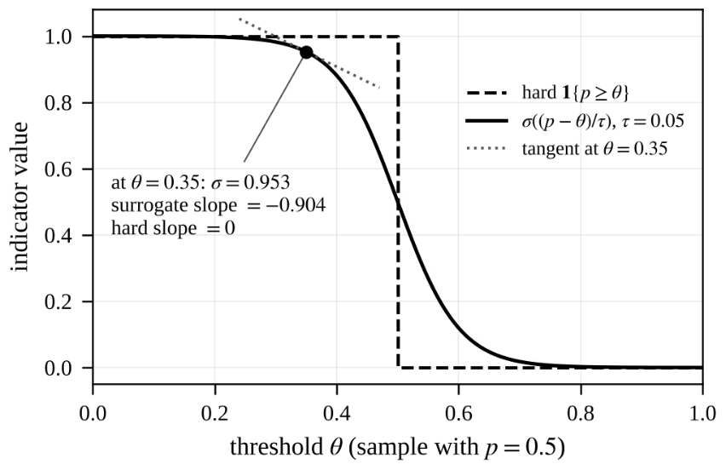

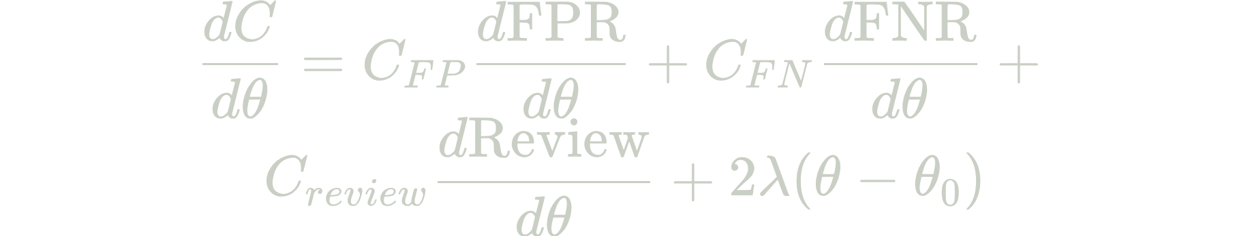
CORE CONTRIBUTION
The core contribution is optimizing the Allow / Review / Block thresholds
Hard cost:
Labelled probabilities: Start from model probabilities.
Sigmoid surrogate: Replace indicators with sigmoid smoothing at τ = 0.05, making numerical derivatives usable.
Derivatives: Use numerical derivatives and constrained gradient descent.
Projected threshold update: Project thresholds to a feasible Allow / Review / Block policy; labelled analyst feedback can trigger a re-run on updated probabilities.
dFPR/dθ uses the sigmoid surrogate to ensure differentiability: d/dθ σ((s-θ)/τ)
C_FP = 1.0, C_FN = 5.0, C_review = 0.5. θr is the Review threshold and θb is the Block threshold; the policy keeps a non-empty review band. Indicator rates have zero derivative almost everywhere.

Slide 7
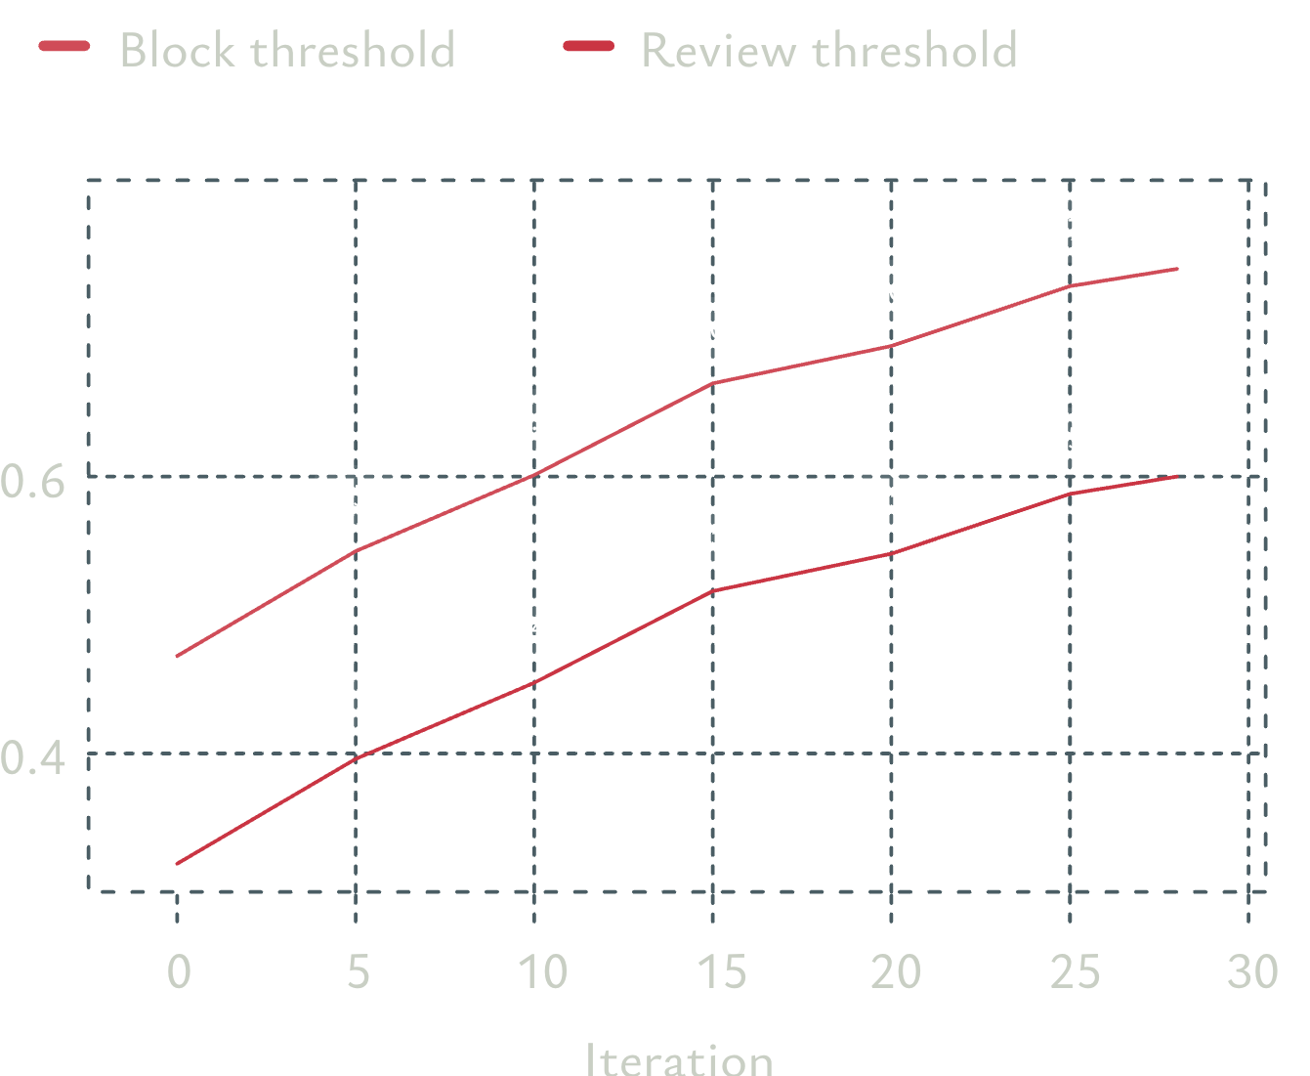
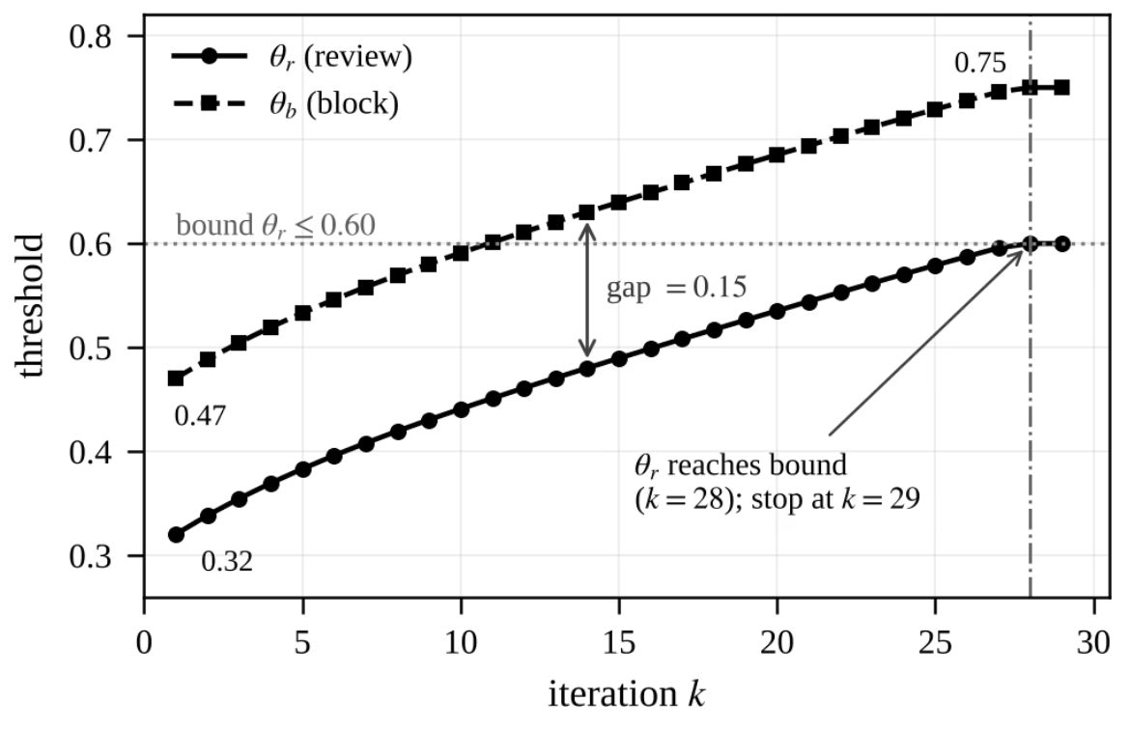
CALCULUS EXPERIMENT
Total expected cost converged from 0.3873 to 0.3676 in 29 iterations
Start near θr = 0.32 and θb = 0.47 with a fixed gap of 0.15.
Projected gradient descent converged to θr = 0.60 and θb = 0.75.
Learning rate η = 0.05; sigmoid temperature τ = 0.05.
Second derivatives at the returned point were positive: 0.4848 for θr and 19.3283 for θb, confirming local minimum.
Total expected cost fell from 0.3873 to 0.3676 as both thresholds moved from θr = 0.32, θb = 0.47 to θr = 0.60, θb = 0.75, preserving the 0.15 review-band gap.

Slide 8
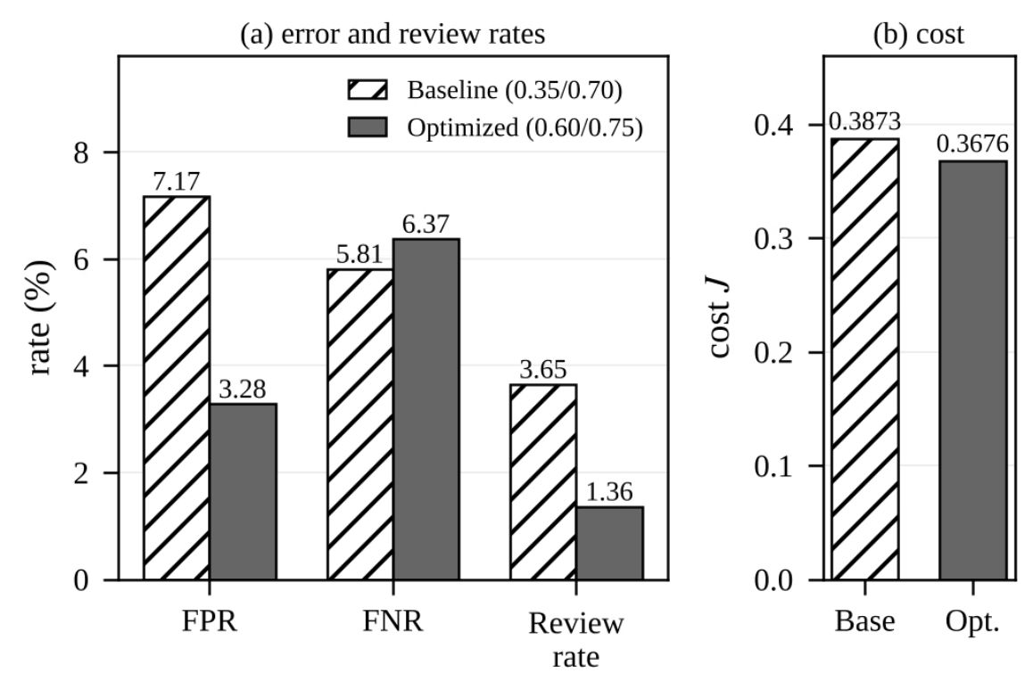
OPERATING-POINT RESULT
Optimizing thresholds reduced friction more than it increased misses
Measure | Baseline | Optimized | Change
Cost | 0.3873 | 0.3676 | 5.1% reduction
False-positive rate | 7.18% | 3.28% | down 54%
Review rate | 3.66% | 1.36% | down 63%
False-negative rate | 5.81% | 6.37% | up 0.56 percentage points
Missed phishing | 221 URLs | 242 URLs | +21 URLs
Higher thresholds sharply reduced false alarms and analyst review, while the false-negative increase remained limited.

Slide 9
ADAPTIVE LOOP
ARES closes the loop from QR scan to adaptive learning
01
02
03
04
Decode offline
Score
Decide and learn
Re-run policy
Decode the QR payload and extract lexical URL features offline.
Score the URL with calibrated XGBoost.
Dashboard returns Allow, Review, or Block; analyst labels become feedback.
Re-run the calculus policy on labelled probabilities, while the heuristic reinforcement-style controller remains available for online refinement.
The system is designed for QR phishing detection without fetching page content.
The heuristic policy uses reward-driven updates; the calculus policy provides an explicit cost objective plus gradient, curvature, and KKT diagnostics.

Slide 10
CONCLUSION
ARES makes the policy itself an optimizable security decision
Takeaway | Evidence
Model | XGBoost + isotonic calibration reached ROC-AUC 0.9929, PR-AUC 0.9976, and Brier score 0.0297, versus Random Forest at 0.9902, 0.9953, and 0.0353.
Operating point | Optimized thresholds 0.60 / 0.75 replaced the hand-chosen 0.35 / 0.70 policy; cost fell 5.1%, FPR fell 54%, and review rate fell 63%.
Future work | Live page and redirect analysis, independently collected evaluation data, wider threshold bounds and full-Hessian analysis, hybrid heuristic-plus-calculus adaptation, and real benign QR traffic.
From URL-only detection to an adaptive, feedback-aware policy.

